Slide 1
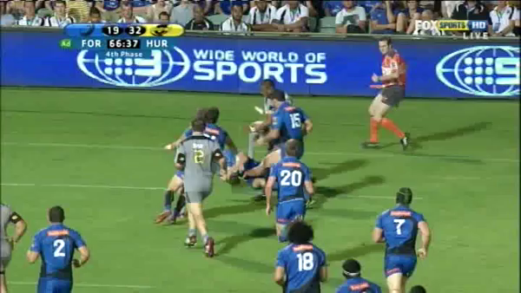
Clear message?
Will the next be YC?
Commentator thinks so!

