Slide 1

Escalation
2017
PART 2

Slide 2
Referee Escalation Process
Look at types of trends
Reviewing the escalation process
Focus on being specific in the ‘final chat’
Note: Intentional infringements (cynical) and single instances foul play deserving of YC/RC sanction are totally different. This presentation is only concerned with addressing repeated infringements.

Slide 3
Identifying Trends
What is a trend?
  an individual player?
  similar infringements (e.g. at breakdown, foul play)?
  tactics in red zone under pressure?
  negative attitude generally / frustration?

Slide 4
Identifying Trends
As referees, is our intervention relevant…
  too early?
  too late?
  when it’s not needed?
  none when it is needed?

Slide 5
Identifying Trends
Having difficulty identifying trends? Refer back to Referee Profile:
  Are we getting quick ball at breakdown?
    e.g. have we had roll PKs?
  Are we getting a contest at the tackle?
    e.g. have we had many turnovers?
  Is there space for players to attack?
    e.g. have we had offside PKs?
  Are we getting good set piece outcomes?
    e.g. have we had FK/PKs? Getting ball out at scrum?

Slide 6
How you might think about escalation
  1. Identify trend (awareness)
  2. Heads Up (comms to captain or player - opportunity)
  3. Final Chat (warning – final opportunity)
  4. Intervention (YC)
  Note: when you give a Heads Up or Final Chat you should assume that the teams will change i.e. it’s important not to go looking for the next “one”, it should stand out.
Notes:
3-4 PKs = Heads Up
4-5 PKs = Final Chat
5-6 PKs = YC … is this about right?

Slide 7
‘Heads up’
At downtime - L/O, scrum, injury, shot for goal
This situation is informal and does not require a time off or double blast of the whistle
"There's been some X, can you address it please?”
No pressure … if trend doesn’t eventuate, happy days

Slide 8
Refer to video in Resources – ‘TIME IS ALREADY OFF’

Slide 9
‘Final chat’
As soon as you call time out / double blast of the whistle, entire attention is now on ref
  Everyone is thinking formal warning or YC
  So, where are you at right now? Don’t call captain out if it’s not a YC warning
  This is not the “head's up”
‘Final’ because you won't be talking about it again!
It’s now obvious to all what the next step is going to be

Slide 10
‘Final chat’
Don't be vague, be clear about what *specifically* the trend is you are addressing
“If that trend continues, you’ll lose a player to the bin”
The ‘old’ referee coaching advice – “don’t back yourself into a corner” is no longer relevant
Better advice is to be specific about what the trend is that would result in a card
This way it is clear in both your mind, and the Captain’s

Slide 11
‘Final chat’
Can you have:
  two different trends at once?
  different trends at different stages of the process?
  examples for discussion…?

Slide 12
Refer video in resources – ‘clear message?’

Slide 13
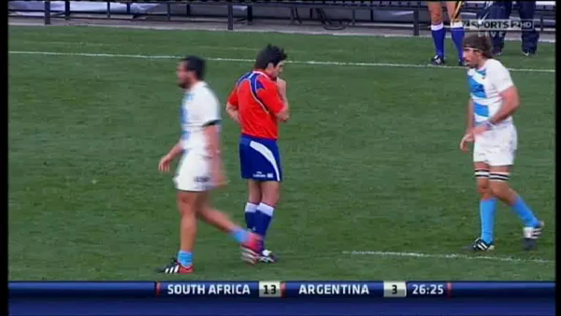
Time is off
YC warning – is the message clear?
What is the tone?

Slide 14
YC intervention (repeated)
Next relevant PK, must give YC or sacrifice credibility
No need for formal process of calling captain out
  Everyone should see it coming, just give the card
What if it's a 50/50?
  Should you be blowing it in the first place?
Trend goes away… how long to re-set?

Slide 15
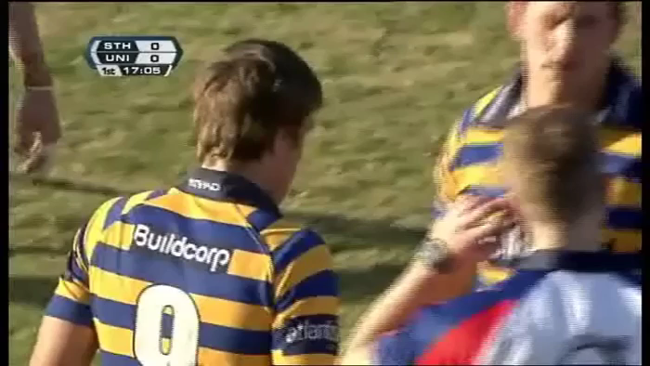
HEADS UP @ downtime
Re tacklers rolling
17 mins

Slide 16
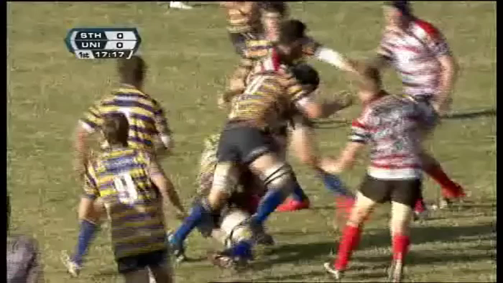
FINAL WARNING @ PK
Re tacklers rolling

