Slide 1
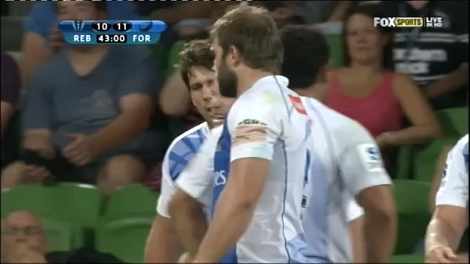
Time is already off
Referee lets captain know what he is seeing

